Slide 1

Industrial Training: My Journey and Achievement
NAME: Kayode peter TEMITOPE
MATRIC NUMBER: 208077
DEPARTMENT: Computer science
it location: itu, college of medicine, ui
SUPERVISOR: MR. AGBOOLA KEHINDE

Slide 2
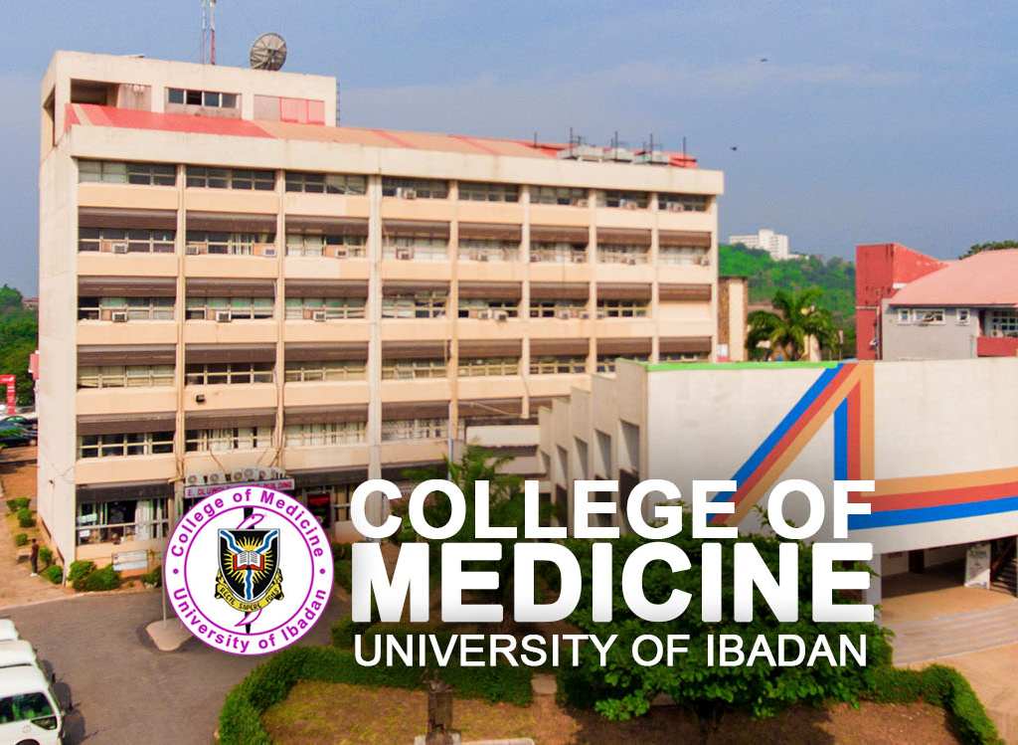
OVERVIEW OF itu
Planning and implementation of College network expansion i.e. new network areas, extension of existing networks
Design of College Website Maintenance and regular update of the College Website
Determine ICT related training needs of the College.
Helpdesk functions(Assist members of staff and units in resolving network related problems)

Slide 3
software and web developement unit
Utilized frontend web development technologies such as HTML, CSS, and JavaScript for constructing web projects.
Made use of Media queries for making the web projects adequately responsive to various sizes of screens for viewing.
Integrated the frontend project with the phpmyAdmin GUI database.
Effectively structured the database tables to ease retrieval of data from it

Slide 4
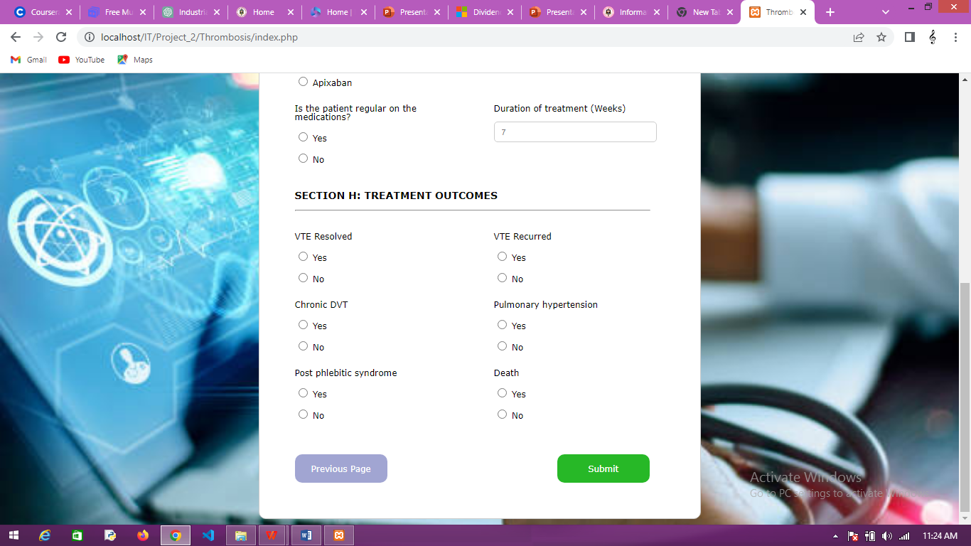
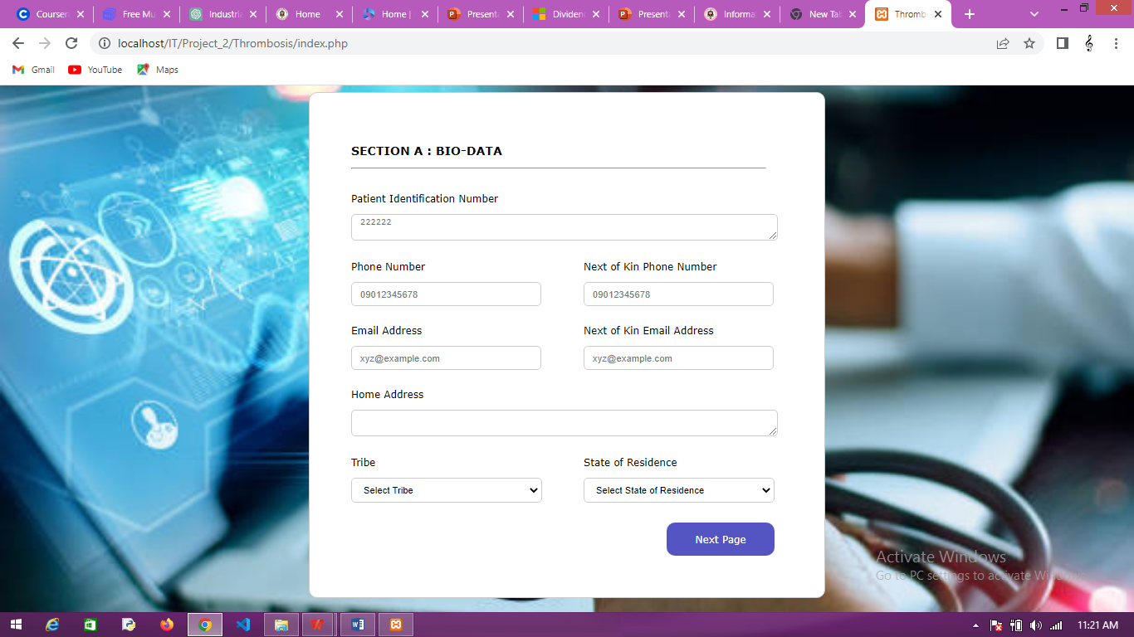
PATIENT DIAGNOSIS FORM
Description
The Patient Diagnosis form is a form designed to take in patients personal information, demographic information and key details as regards various symptoms, previous medical records and other key details to ensure easy and efficient diagnosis.
Stacks
HTML
CSS
Javascript
PHP

Slide 5
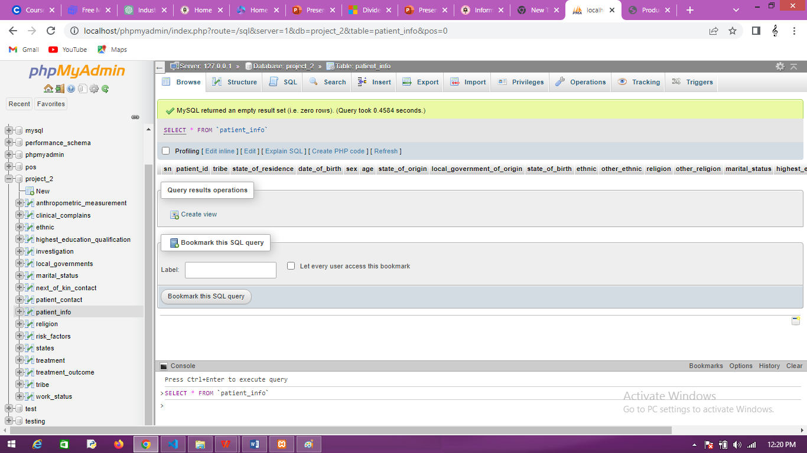
patient diagnosis form
Database

Slide 6
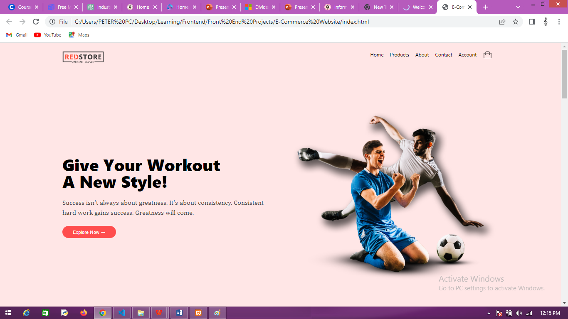
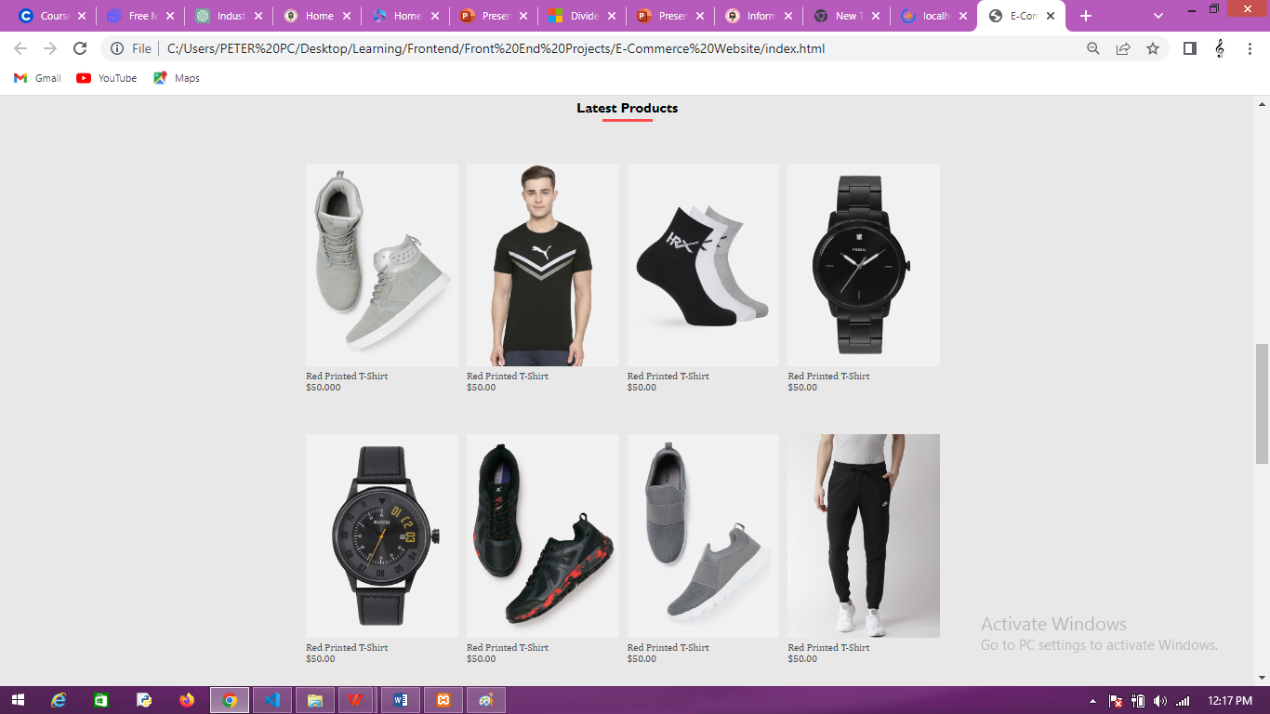
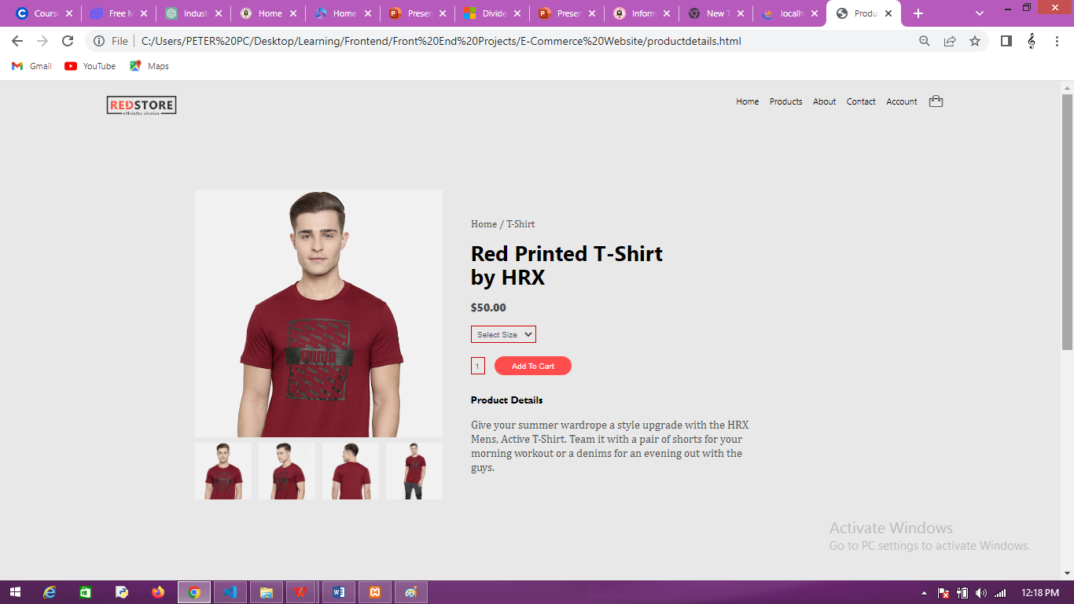
E-Commerce website
Description
Redstore is a web based application for purchase of quality wears from the comfort of one's home. Redstore also houses different online stores for easy purchase.
Stacks
HTML
CSS
Javascript

Slide 7
Networking and system management unit
Learnt the basics and concepts of networking in practicality
Helpdesk functions(Assist members of staff and units in resolving network related problems)
Learnt to crimp network cables, while also assisting in the network troubleshooting processe.
Learnt the basics of IP addressing and subnetting

Slide 8
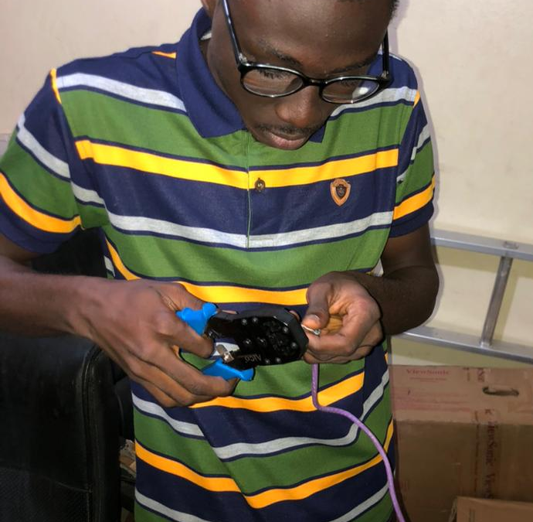
Crimping of network cables
Description
Crimping a network cable involves securing connectors at the cable ends, ensuring dependable connections in Ethernet networks. This is vital for creating customized cables of different lengths and maintaining proper signal transmission.
Ethernet cable wiring standards
Straight-through
Crossed

Slide 9

Network troubleshooting
By going alongside with a staff for troubleshooting and resolving of network issues, I acquired hands-on experience in network troubleshooting through diagnosing and resolving various connectivity issues, employing my knowledge of network protocols and tools to ensure seamless network operations.

Slide 10
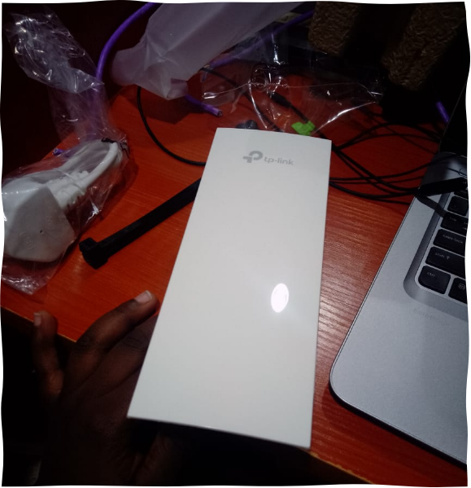
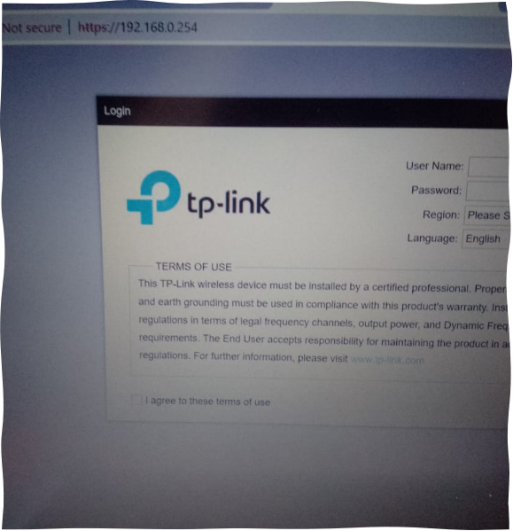
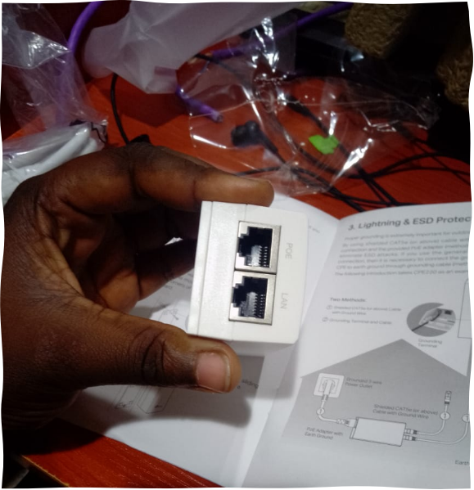
Access point configuration
I honed my ability to configure access points effectively through hands-on experience, mastering wireless network setup, security protocols, and coverage optimization. This encompassed managing SSIDs, encryption, and channels for seamless connectivity, tailoring configurations to specific network demands.

Slide 11
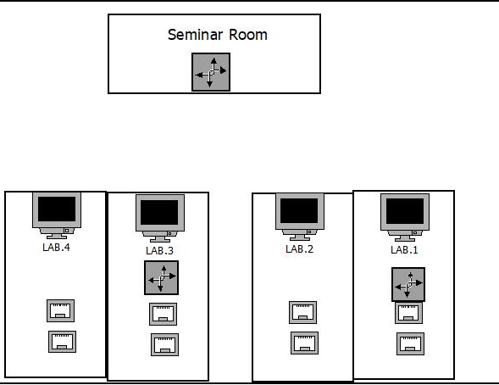
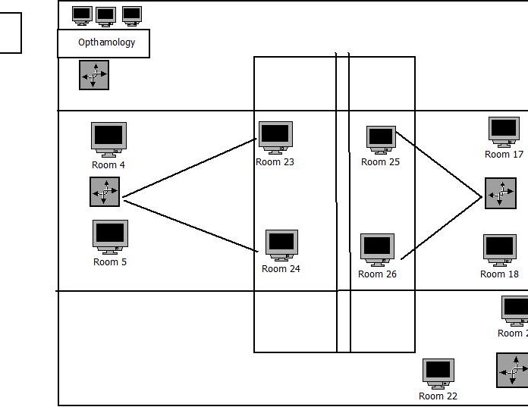
Use of Dia software
I used Dia software to craft a prototype network layout for the vertical extension building, effectively illustrating the placement of networking components. Employing Dia's tools, I designed an organized network structure that enhanced communication and connectivity throughout the building.

Slide 12
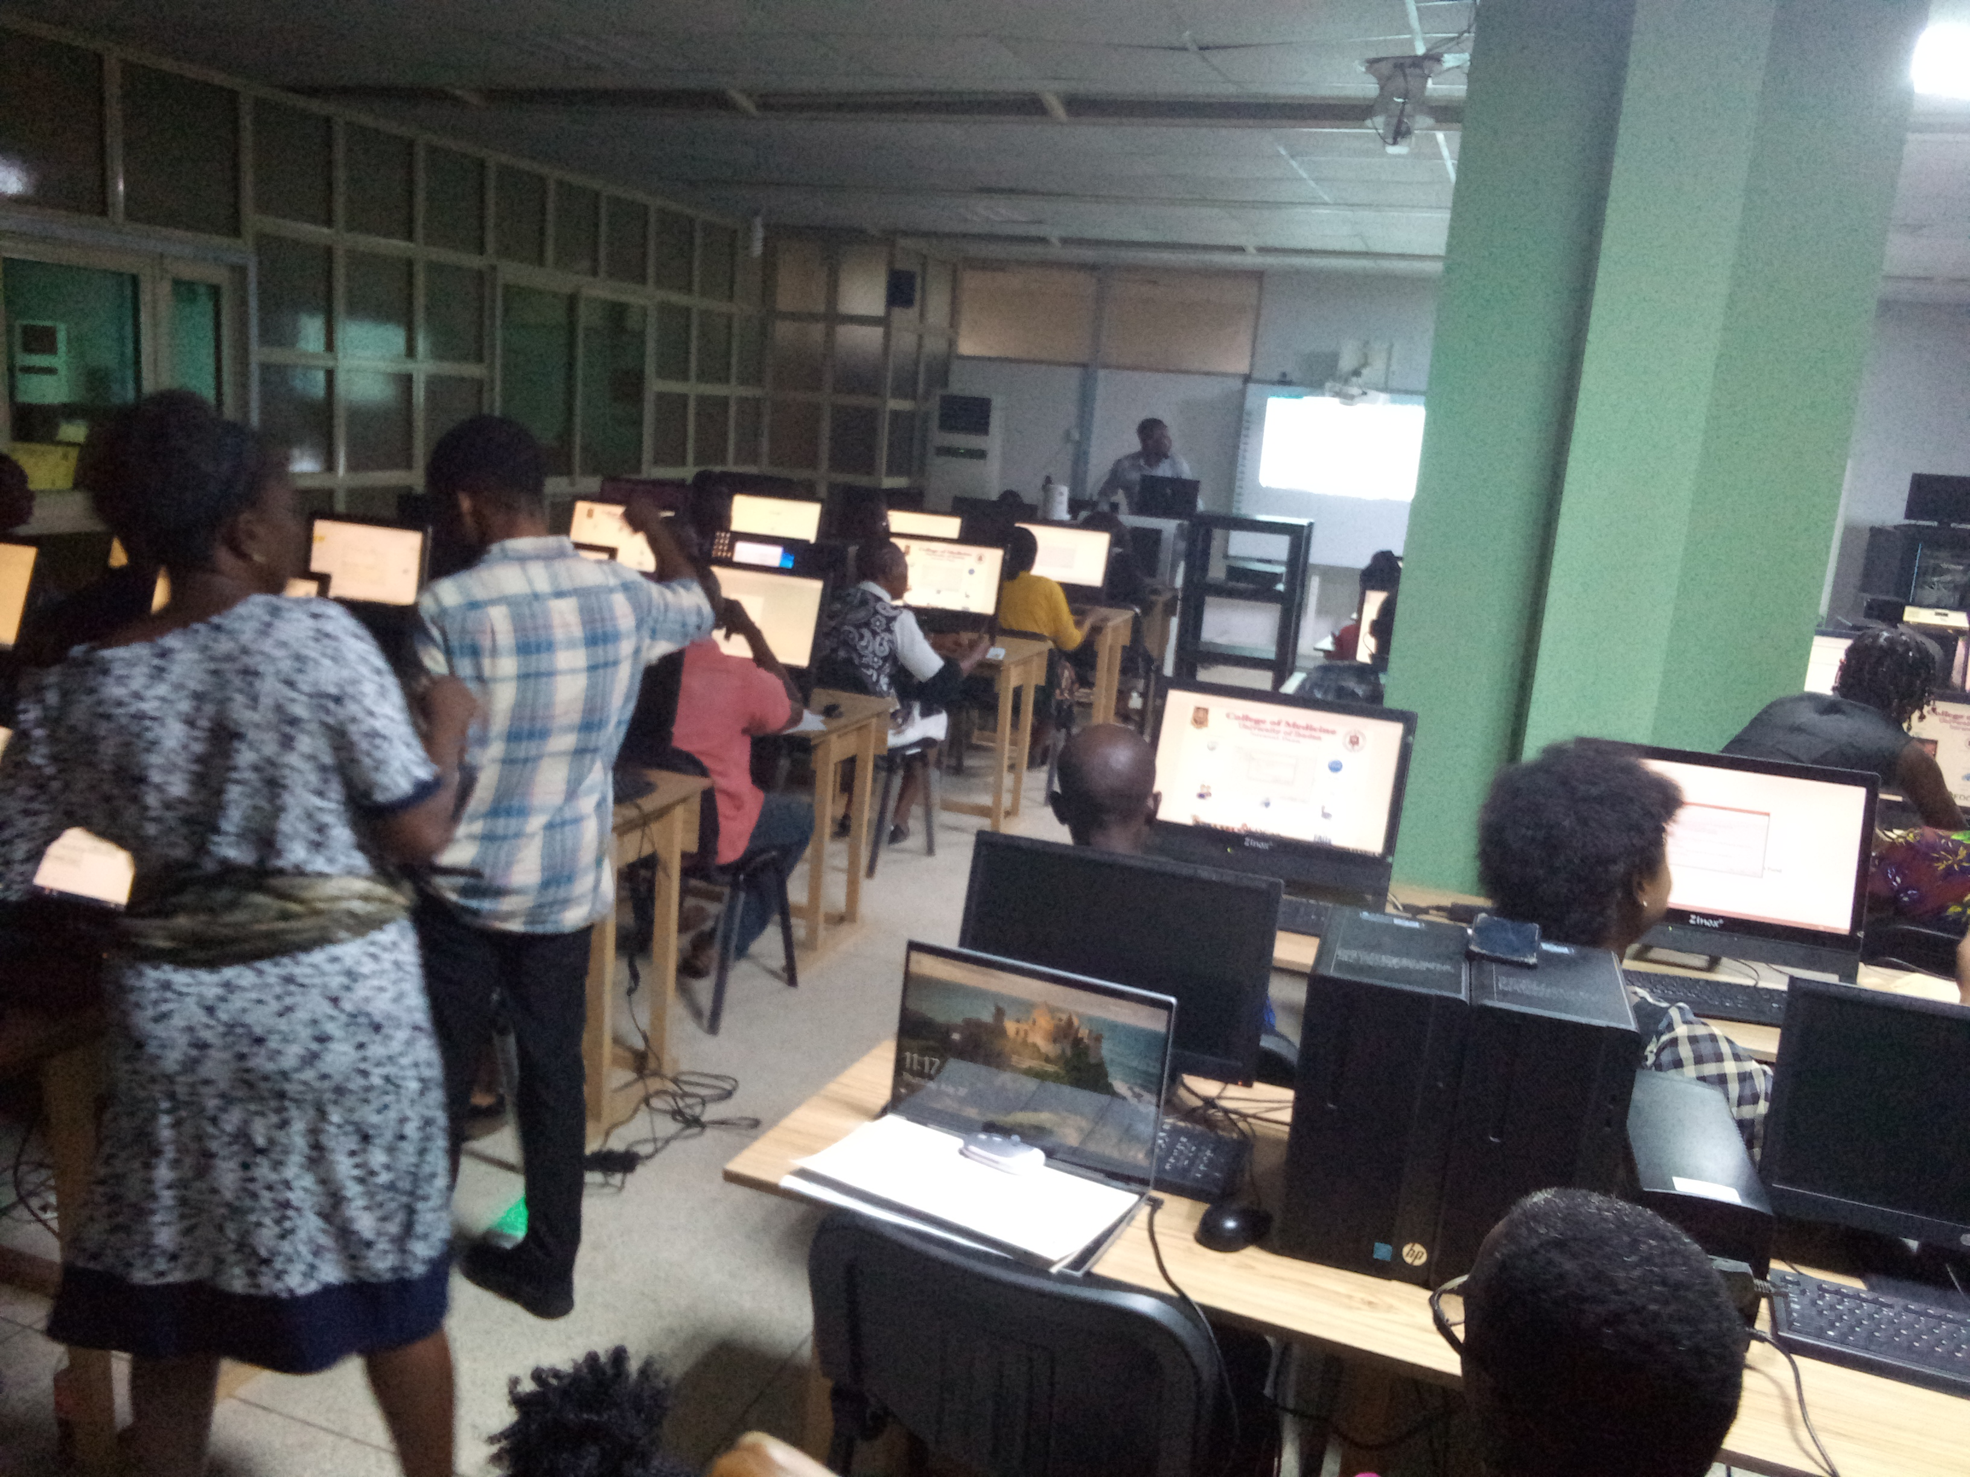
staff Ict training assistance
I provided support during an ICT training by addressing staff members' technical needs and concerns, ensuring a seamless learning experience as they used their computers while the tutor delivered lectures. This assistance contributed to a productive training session and enhanced participants' understanding of the material.

Slide 13
conclusion
My industrial Training at the ITU, College of Medicine was a valuable post-education experience that enhanced my digital communication, information management, and interpersonal skills. It also exposed me to communication challenges within the College system , prompting me to adopt a more anlytical approach to problem-solving using advanced technology.

Slide 14
recommendation
The Industrial Training Coordinating Centre (ITCC) should seek more in working hand in hand with various and multiple large companies in order to ease the placement of students to organizations more relevant to student’s field of interest.

Slide 15
thank you

